Slide 1

IT5182
Fundamentals of Data Models and Databases
Entity Relationship (ER) Modelling

Slide 2

Describe data modelling and why data models are important for database design
Explain what business rules are and how they strongly influence database design
Explain Entity Relationship diagrams and their components
Recognise the importance of primary keys and foreign keys in the design of database tables

Slide 3

Most information systems involve a database to permanently record organisational data e.g. customer and product details.
A database is an organised and often complex collection of data that documents relevant aspects of reality (for example, the availability of rooms in hotels), in a way that supports the processing required (for example, finding a hotel with vacancies).
Since databases are complex engineered products, developers need to design them using a data model.

Slide 4

Data models
  Relatively simple representations of complex real-world data structures and business rules
    Often graphical
  Data modeling reduces complexities of database design
Model: an abstraction (representation) of a real-world object or event
  Useful in understanding complexities of the real-world environment
Data modelling is iterative and progressive

Slide 5

There are many types of data model (reflecting differing implementation technologies), but we will focus initially on the relational data model
Developed by E. F. Codd (IBM) in 1970
A central concept is the Table:
  consisting of rows and columns

Slide 6

Data models are used to capture several types business rules that exist within an organisation
Business rules are descriptions of policies, procedures and business structures within a specific organisation
They describe the operations to create/enforce actions within an organisation’s environment (i.e. it’s behaviour)
Must be in writing and kept up to date
Most rules are also documented graphically in a variety of models
Must be easy to understand and should be validated by users

Slide 7

Sources of business rules:
  Company managers
  Policy makers
  Department managers
  Written documentation
    Procedures
    Standards
    Operations manuals
  Direct interviews with end users

Slide 8

ERD’s are a type of Relational Data Model i.e. they are used to design relational databases.
ERDs attempt to capture an organisation’s business rules relating to its data requirements, including its structural details.
ERDs consist of 3 main components:
  Entities
  Attributes
  Relationships

Slide 9

Entity: anything of significance about which data is required to be collected and stored e.g. Student, Order, Product, Enrolment. Entities are implemented as Tables in relational databases.
Attribute: a characteristic of an entity e.g. student Name. Attributes are implemented as columns within a table.
Relationship: describes an association between two entities (e.g. a Customer places Orders). There a three types of relationship:
  One-to-many (1:M) relationship
  Many-to-many (M:N or M:M) relationship
  One-to-one (1:1) relationship

Slide 10

Entity Set: A term used during the analysis phase of systems development project i.e. when we model the required system. They are physically implemented as database tables. The term Entity Set is usually abbreviated to Entity by most developers.
Entity Instances/Occurrences represent individual ‘example’ from an entity set – they can be thought of as a row/record within a table, once the system has been implemented.

Slide 11

An association between entities
Participants are entities that participate in a relationship
Relationships between entities always operate in both directions
Relationships can be classified as either 1:M, 1:1 or M:N

Slide 12

Connectivity
  Describes the relationship classification i.e. 1:M, 1:1 or M:N
Cardinality
  Expresses minimum and maximum number of entity occurrences associated with one occurrence of related entity
Established by very concise statements known as business rules

Slide 13
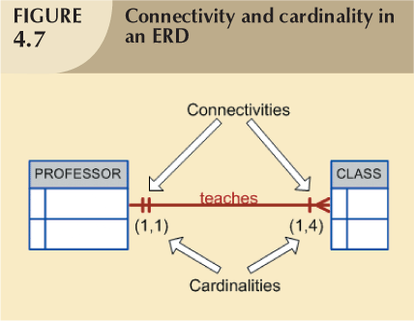

Slide 14

Optional participation
  An entity occurrence does not require a corresponding entity occurrence in particular relationship
Mandatory participation
  One entity occurrence requires corresponding entity occurrence in particular relationship

Slide 15




Slide 16
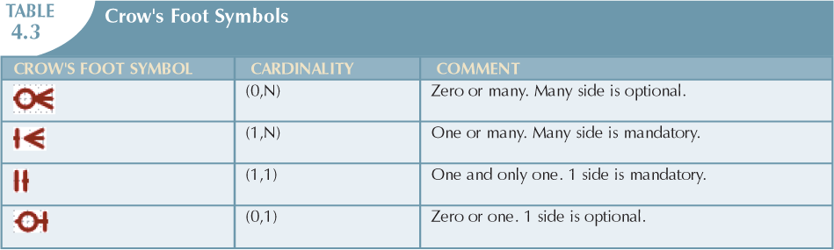

Slide 17
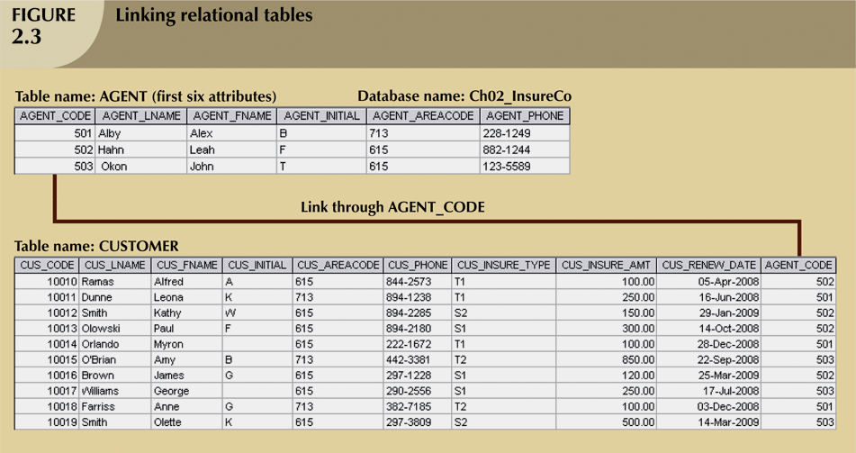
Relationships: Implemented by cross-referencing (Agent Code in this example)

Slide 18

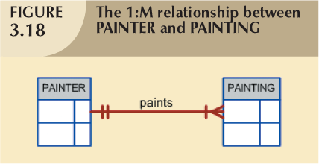
Relational database norm
Found in any database environment

Slide 19
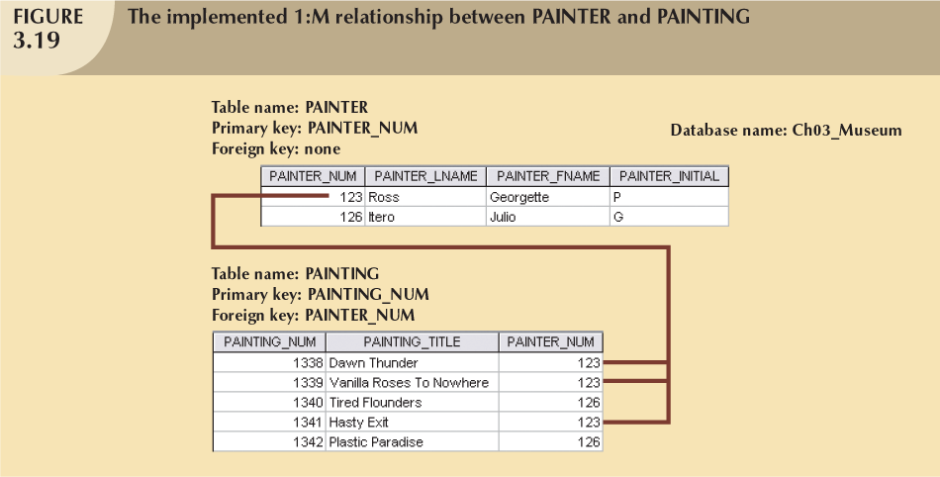
The primary key at the 1 end of the relationship (Painter_Num in the Painter entity) becomes the foreign key at the many end of the relationship (Painter_Num in the Painting entity)

Slide 20

One entity related to only one other entity, and vice versa
Could indicate that two entities actually belong in the same table
Certain conditions absolutely require their use

Slide 21
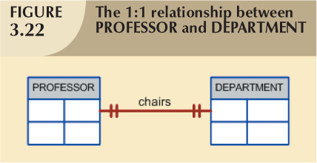

Slide 22

Although these relationships exist in the real world, they are too complex to implement within a relational database.
Implemented by breaking it up to produce a set of 1:M relationships. This is described in more detail in lecture 3.

Slide 23
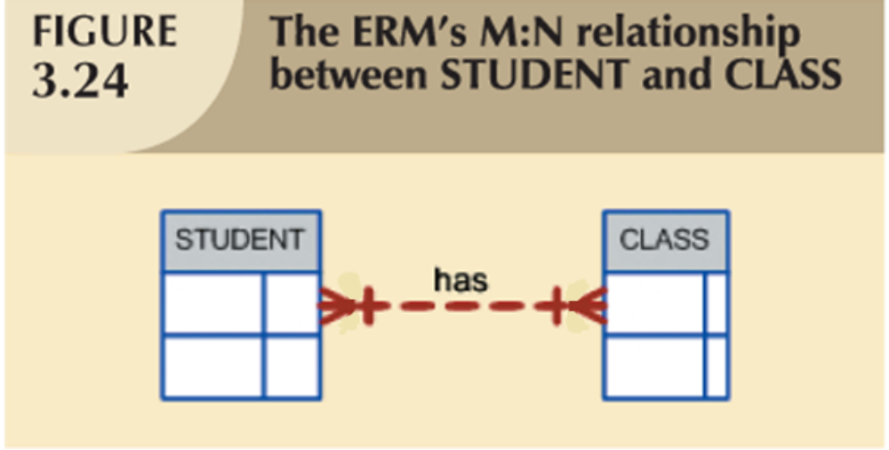

Slide 24

Attributes describe entities – they become columns within a table in the built system
Attributes can be either mandatory or optional
Mandatory attribute: each row must have a value for a mandatory attribute.
Optional attribute: may be left empty
Primary Key: one or more attributes that uniquely identify each entity instance (i.e. each row in a table)

Slide 25

Each row in a table must be uniquely identifiable i.e. must have a primary key
Primary Key is one or more attributes that determine the values of all other attributes in an entity
A Primary Key’s role is based on determination
  If you know the value of attribute A, you can determine the value of attribute B
  For example, in an entity called Student, Student ID might be used as a primary key. Each student will a unique Student ID and so knowing this value will allow a user to determine the name, address and other details recorded about that student.

Slide 26

Null Values:
  Nulls i.e. when the user enters no data for an attribute
  A null value is not permitted for a primary key
  Should be avoided in other attributes, but not always possible
  Can represent
    An unknown attribute value
    A known, but missing, attribute value
    A “not applicable” condition

Slide 27
Foreign Keys:
  Makes the relational database work
  Tables within the database share common attributes (the primary key at the one end of the relationship and the foreign key at the many end)
    Enables tables to be linked together by cross-referencing (implementing the relationship between them) – see example on the next slide.

Slide 28
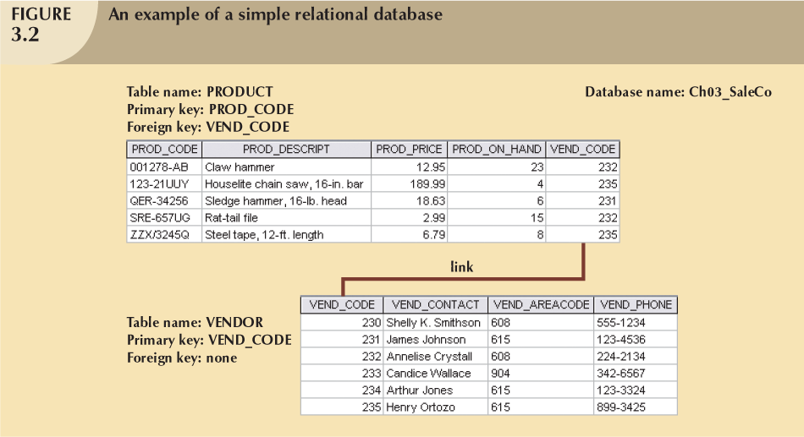
The primary key at the 1 end of the relationship (Vendor_Code in the Vendor entity) becomes the foreign key at the many end of the relationship (Vendor_Code in the Product entity)

Slide 29
Foreign key (FK)
  An attribute whose values match primary key values in the related table
Referential integrity
  If a FK contains a value, it must refer to an existing row/record in another table

Slide 30
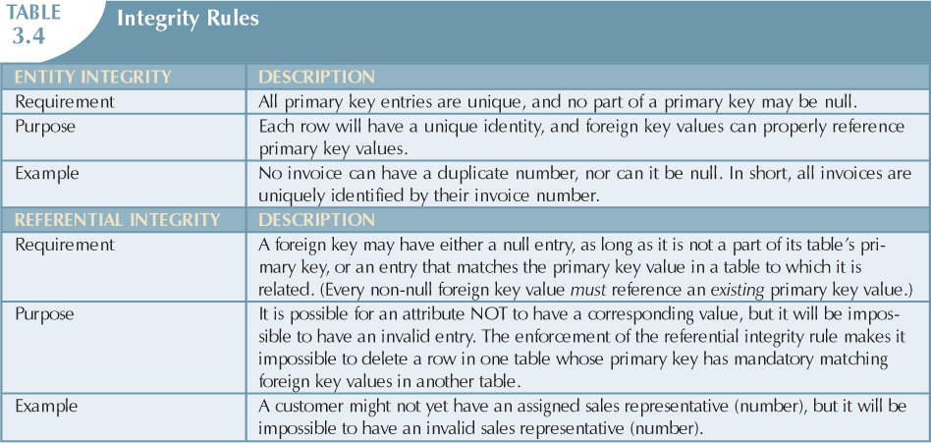

Slide 31

Generally, nouns translate into entities (e.g. Student)
Verbs translate into relationships among entities (e.g. Enrols)
Relationships are bidirectional (e.g. Customer has a relationship with Order and vise versa)
Two questions to identify the relationship type:
  How many instances of entity B are related to one instance of entity A?
  How many instances of entity A are related to one instance of entity B?
  E.g. Each Customer may place many Orders, but each Order is raised only for one Customer

Slide 32

Database design is an iterative process
  Create detailed narrative of organisation’s description of operations
  Identify business rules based on description of operations
  Identify main entities and relationships from business rules
  Develop initial ERD
  Identify attributes and primary keys that adequately describe entities
  Revise and review ERD

Slide 33

An SQL-based relational database application involves three parts:
  User interface
    Allows end user to interact with the data
  Set of tables stored in the database
    Each table is independent from another
    Rows in different tables related based on common values in common attributes
  SQL “engine”
    Executes all queries to retrieve or modify data within the tables using Structured Query Language (SQL – pronounced as sequel)

Slide 34

A data model is an abstraction of a complex real-world data environment
Basic data modeling components:
  Entities
  Attributes
  Relationships
Business rules identify and define basic modeling components

Slide 35

Relational model
  Current database implementation standard
  ER model is a tool for data modeling
    Complements relational model
Tables are basic building blocks of a relational database
Primary Keys are central to the use of relational tables

Slide 36

Each table row must have a primary key that uniquely identifies all attributes in that row
Tables linked by common attributes
Good design begins by identifying entities, attributes, and relationships
  1:1, 1:M, M:N

